Slide 1
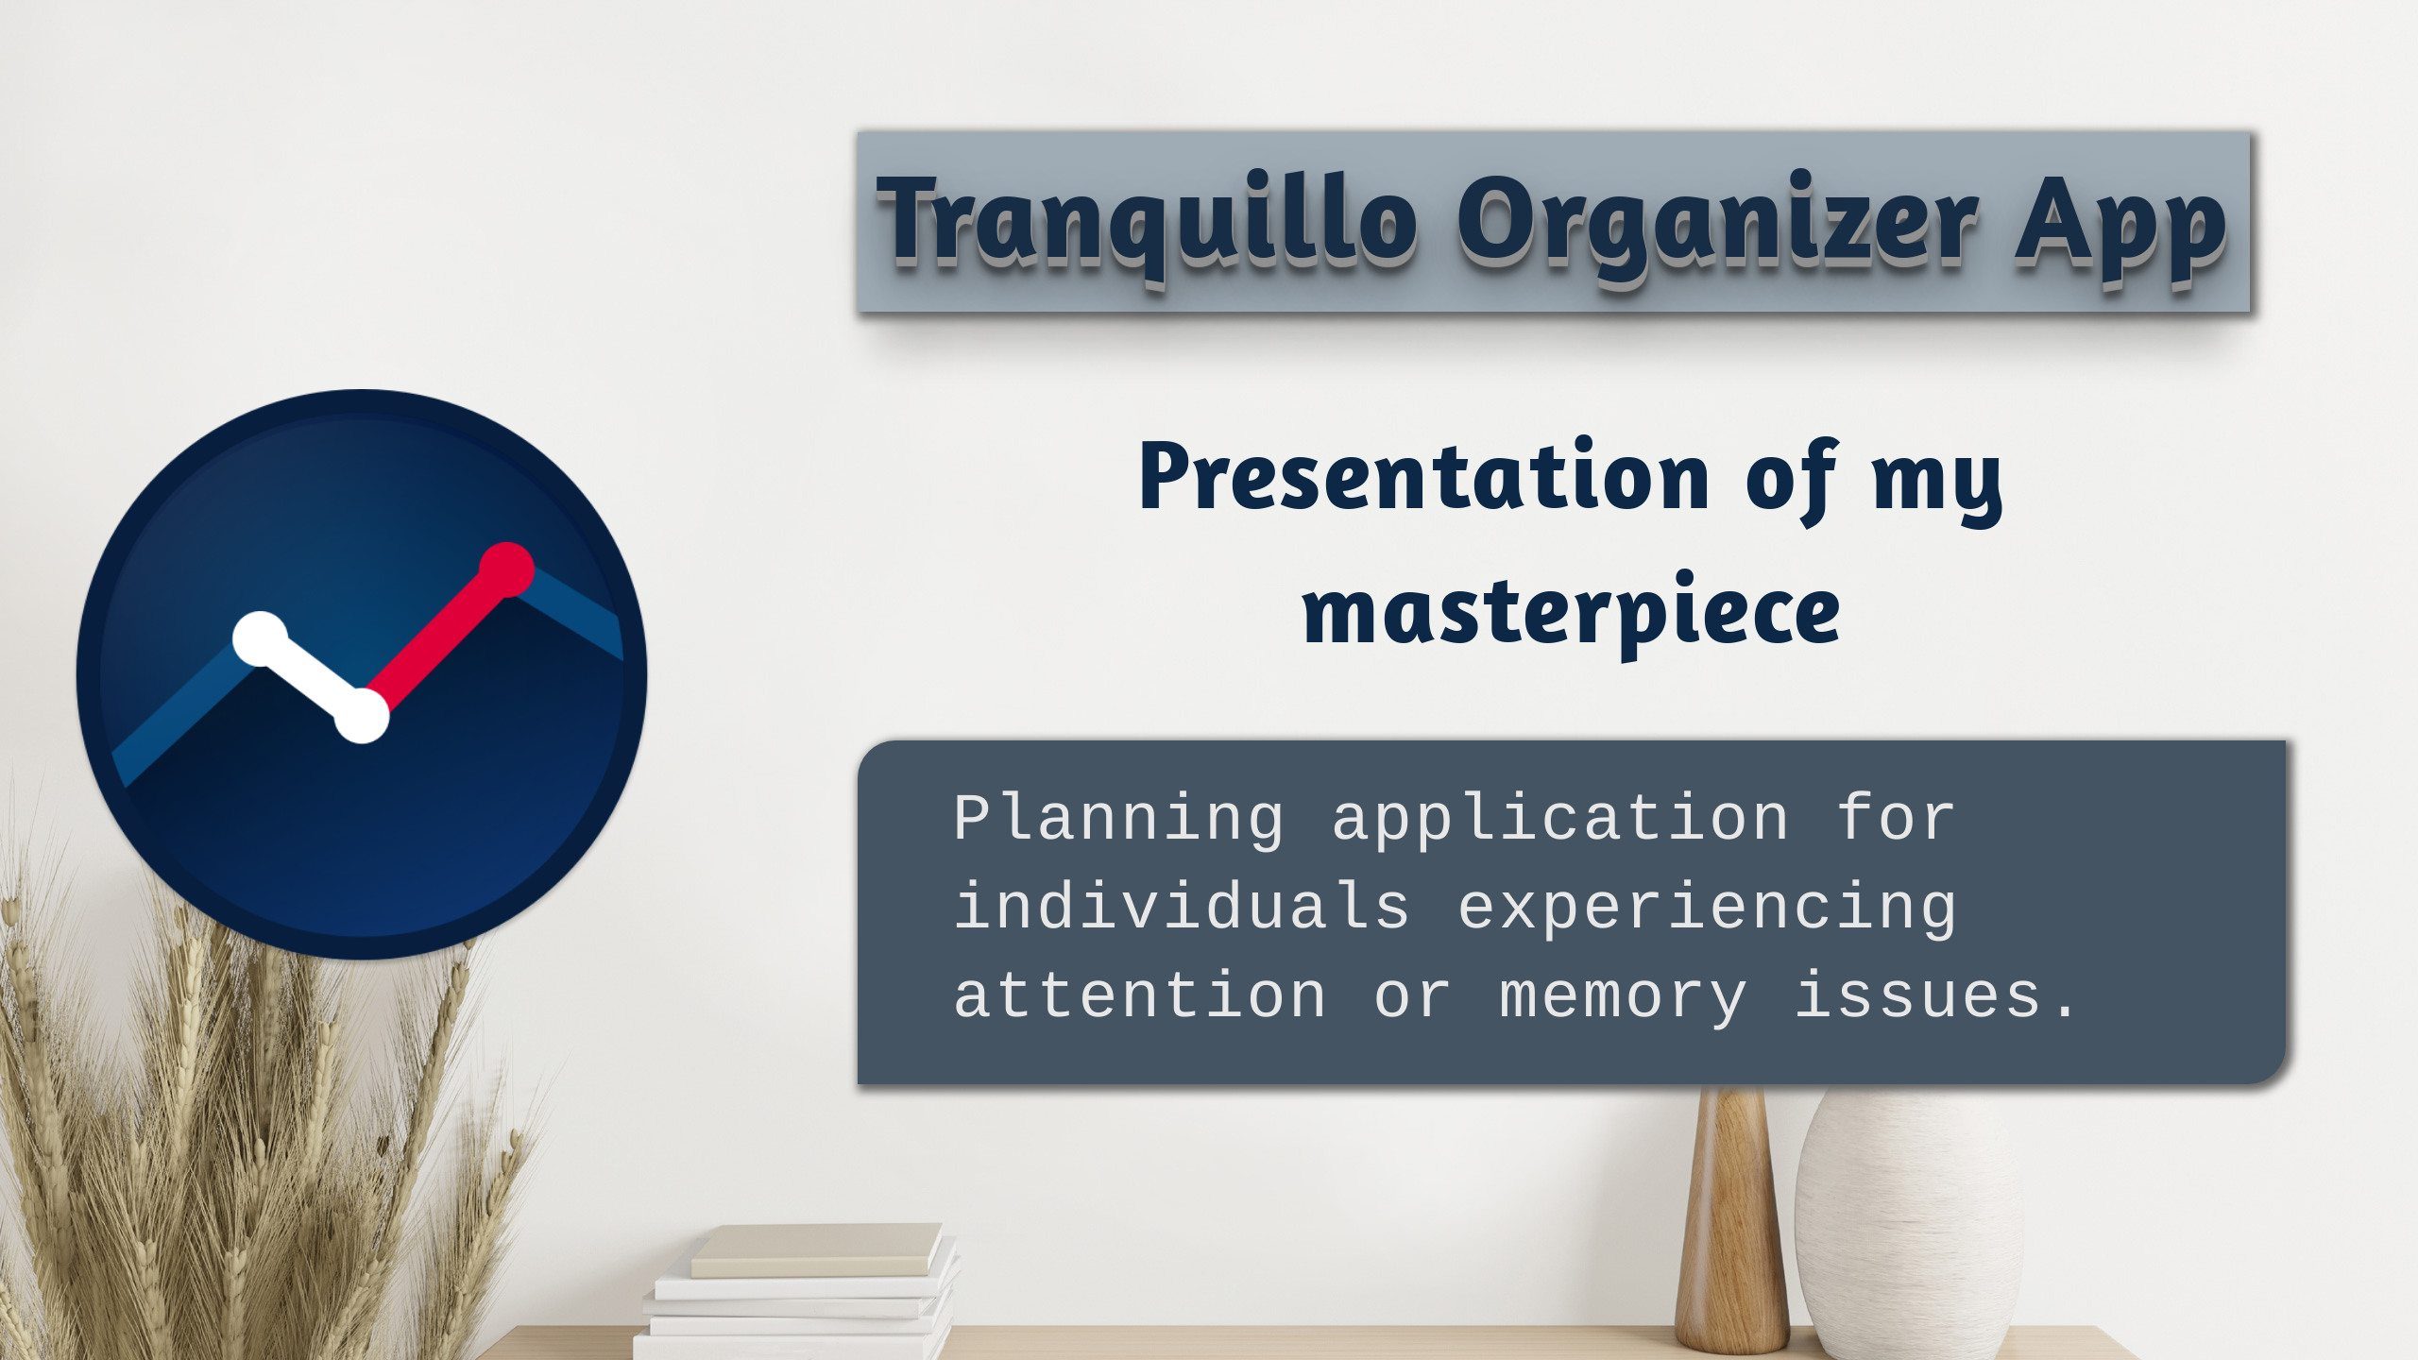
Notes:
# note:
Ladies and gentlemen,
Thank you for welcoming me to introduce my masterpiece, the Tranquillo Organizer App, before you today.

Slide 2
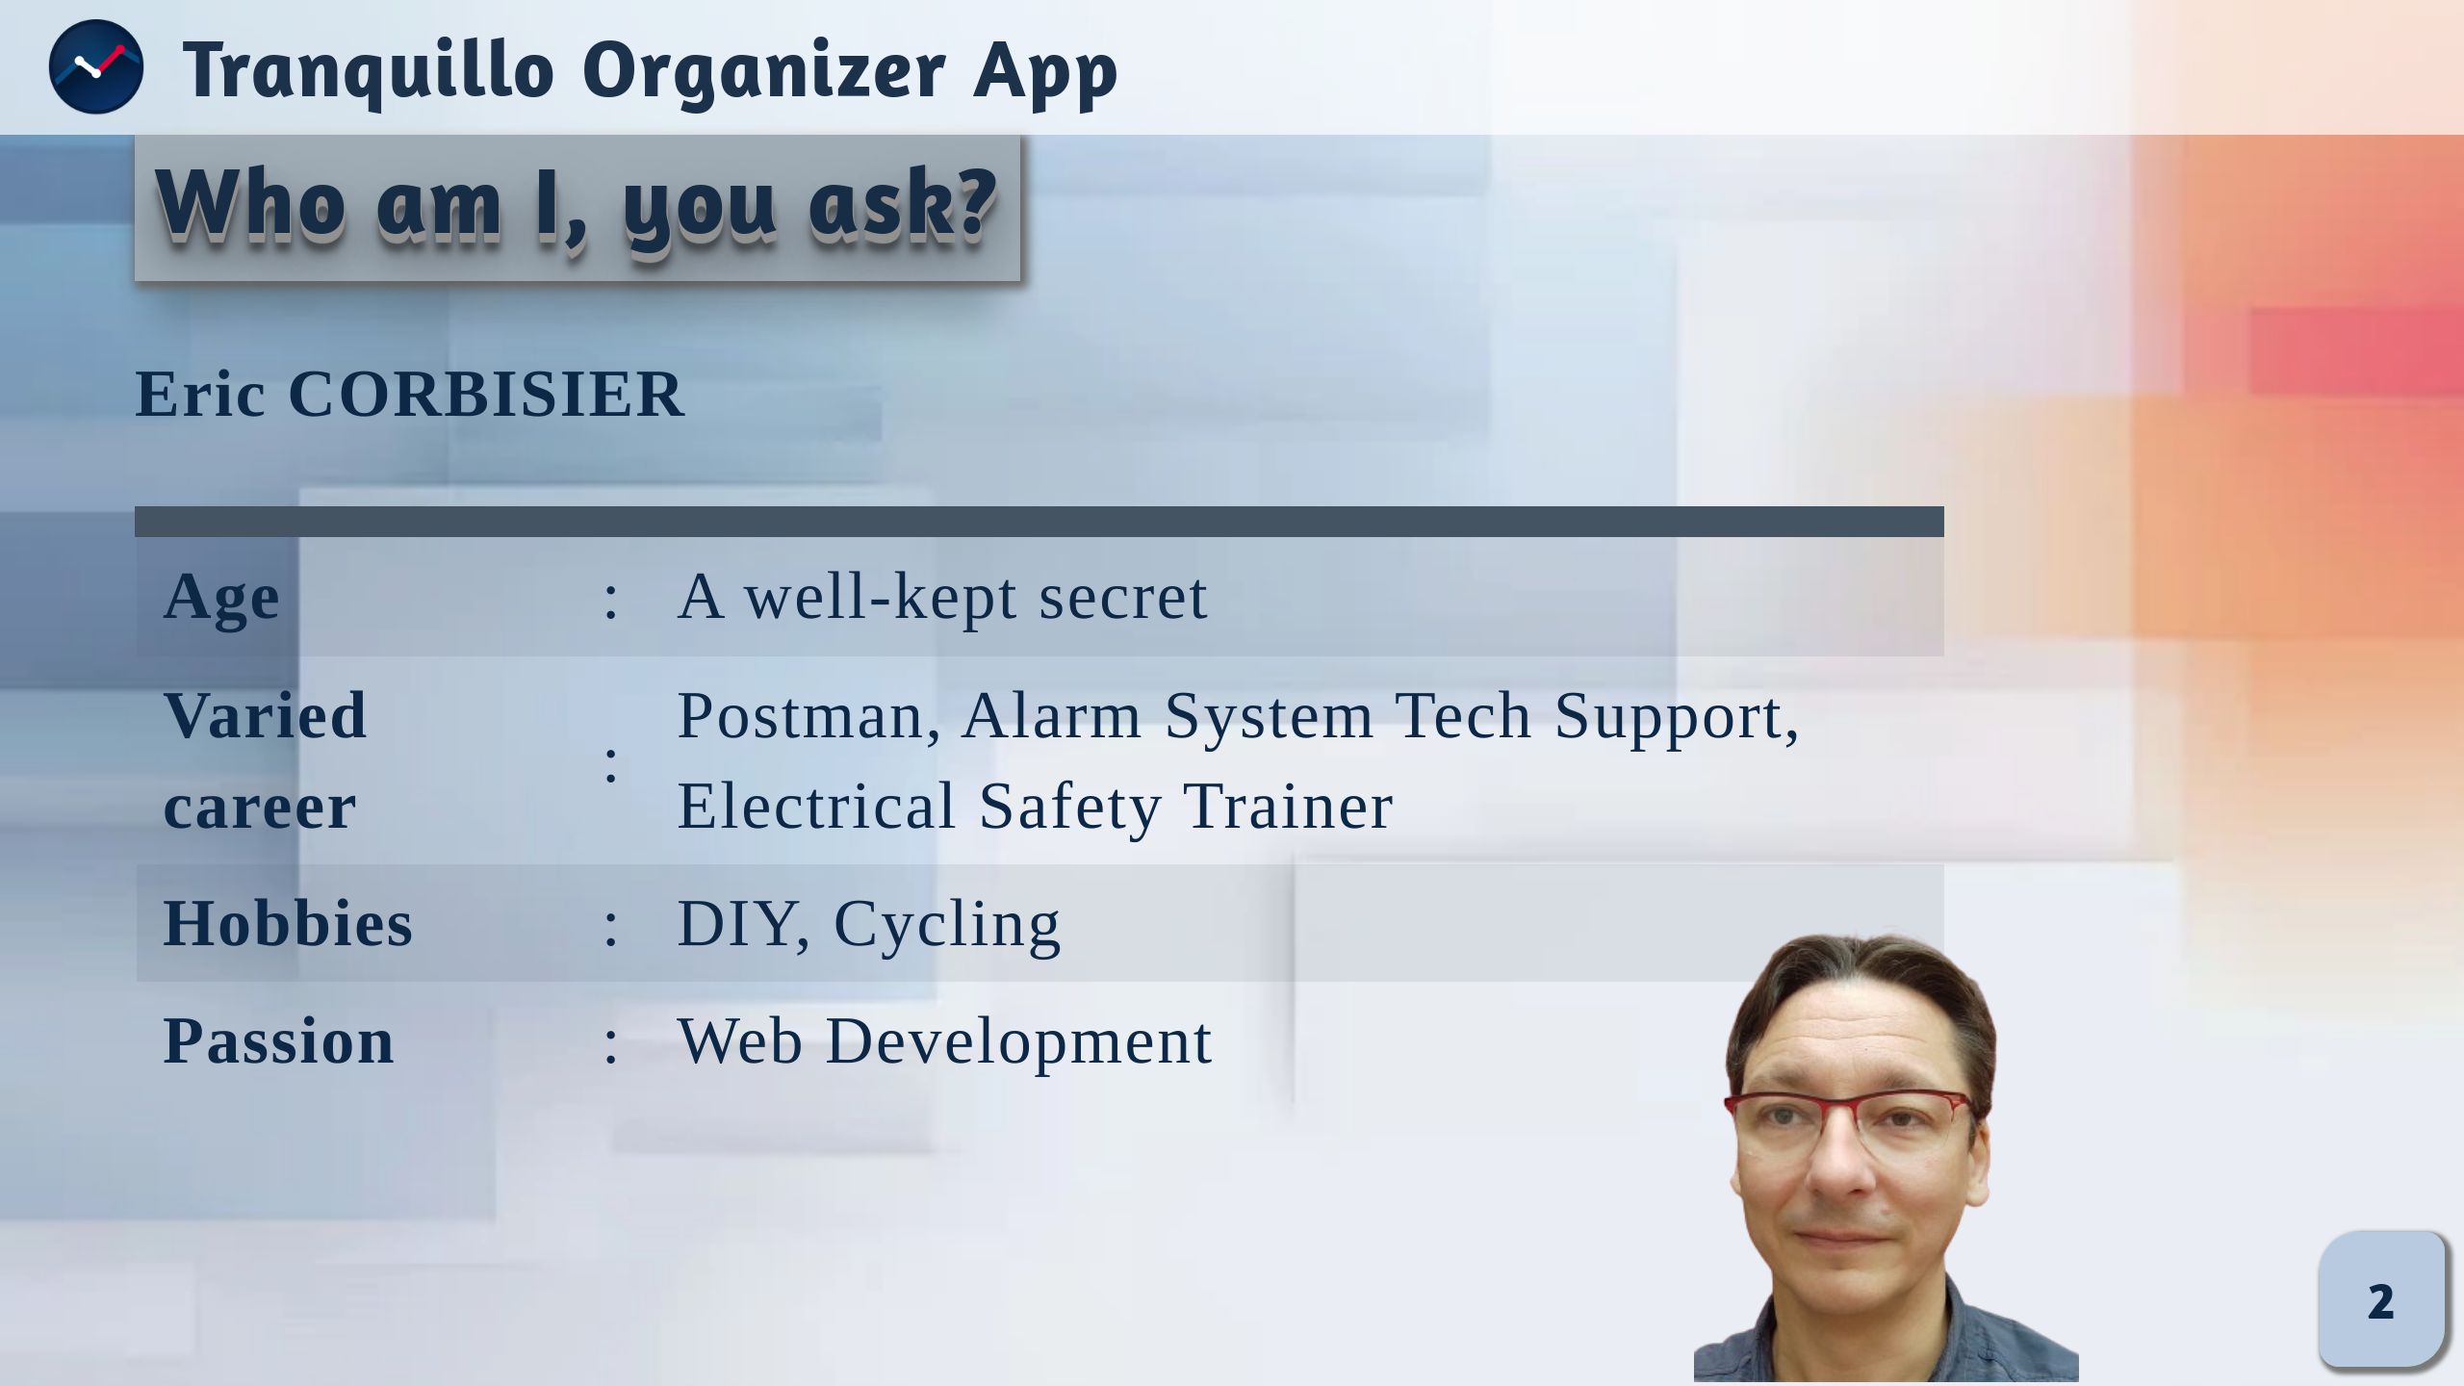
Notes:
# note:
Allow me, first of all, to introduce myself – I am Eric Corbisier. My age, well, let's just say it's a number that no longer rolls off the tongue effortlessly. Over the years, I've worn various hats, starting as a postman, then navigating the realm of alarm system technical support, and eventually finding my stride as an electrical safety training instructor.
When I'm not immersed in my professional endeavors, you'll find me reveling in the joy of hands-on projects and cycling adventures. Yet, my heart belongs to the world of codes and pixels. I am fervently passionate about all things related to computer wizardry, with a particular fondness for web development. In essence – a concoction of diverse experiences, a fervent DIY enthusiast, a cycling aficionado, and an unabashed lover of the intricate dance between lines of code on the vast canvas of the web.

Slide 3
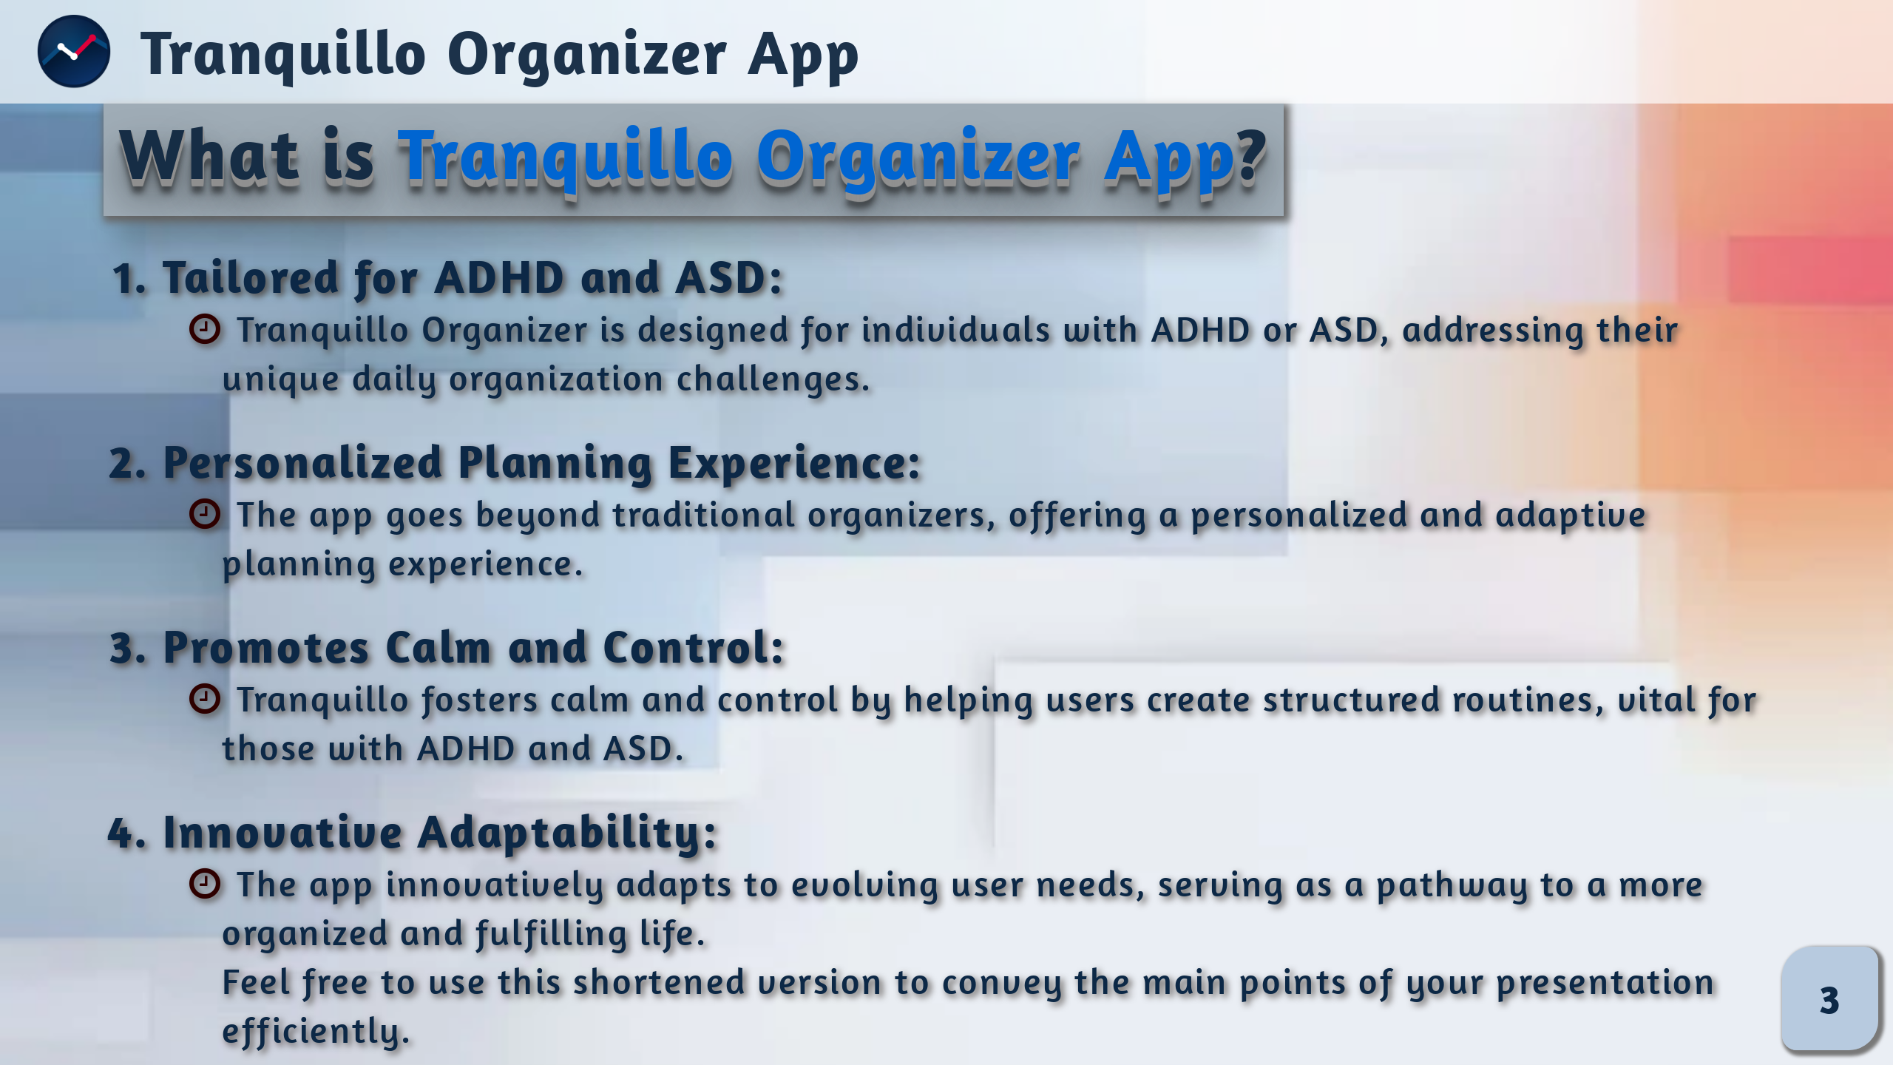
Notes:
# Notes:
I'm thrilled to introduce the Tranquillo Organizer App, a groundbreaking solution specifically designed for anyone dealing with challenges related to daily organization, such as Attention Deficit Hyperactivity Disorder (ADHD) or Autism Spectrum Disorder (ASD). Our app offers a personalized and adaptive planning experience, addressing the unique needs of these users.
Unlike traditional organizers, Tranquillo goes beyond mere scheduling; it becomes a supportive companion, understanding and adapting to the user's preferences. Through an intuitive interface, it helps create structured routines, fostering a sense of calm and control essential for individuals with ADHD and ASD.
The innovation of our app lies in its adaptability, ensuring a dynamic user experience that evolves with changing needs. Tranquillo Organizer is not just a planner; it's a pathway to a more organized and fulfilling life for those facing the challenges of ADHD or ASD.

Slide 4
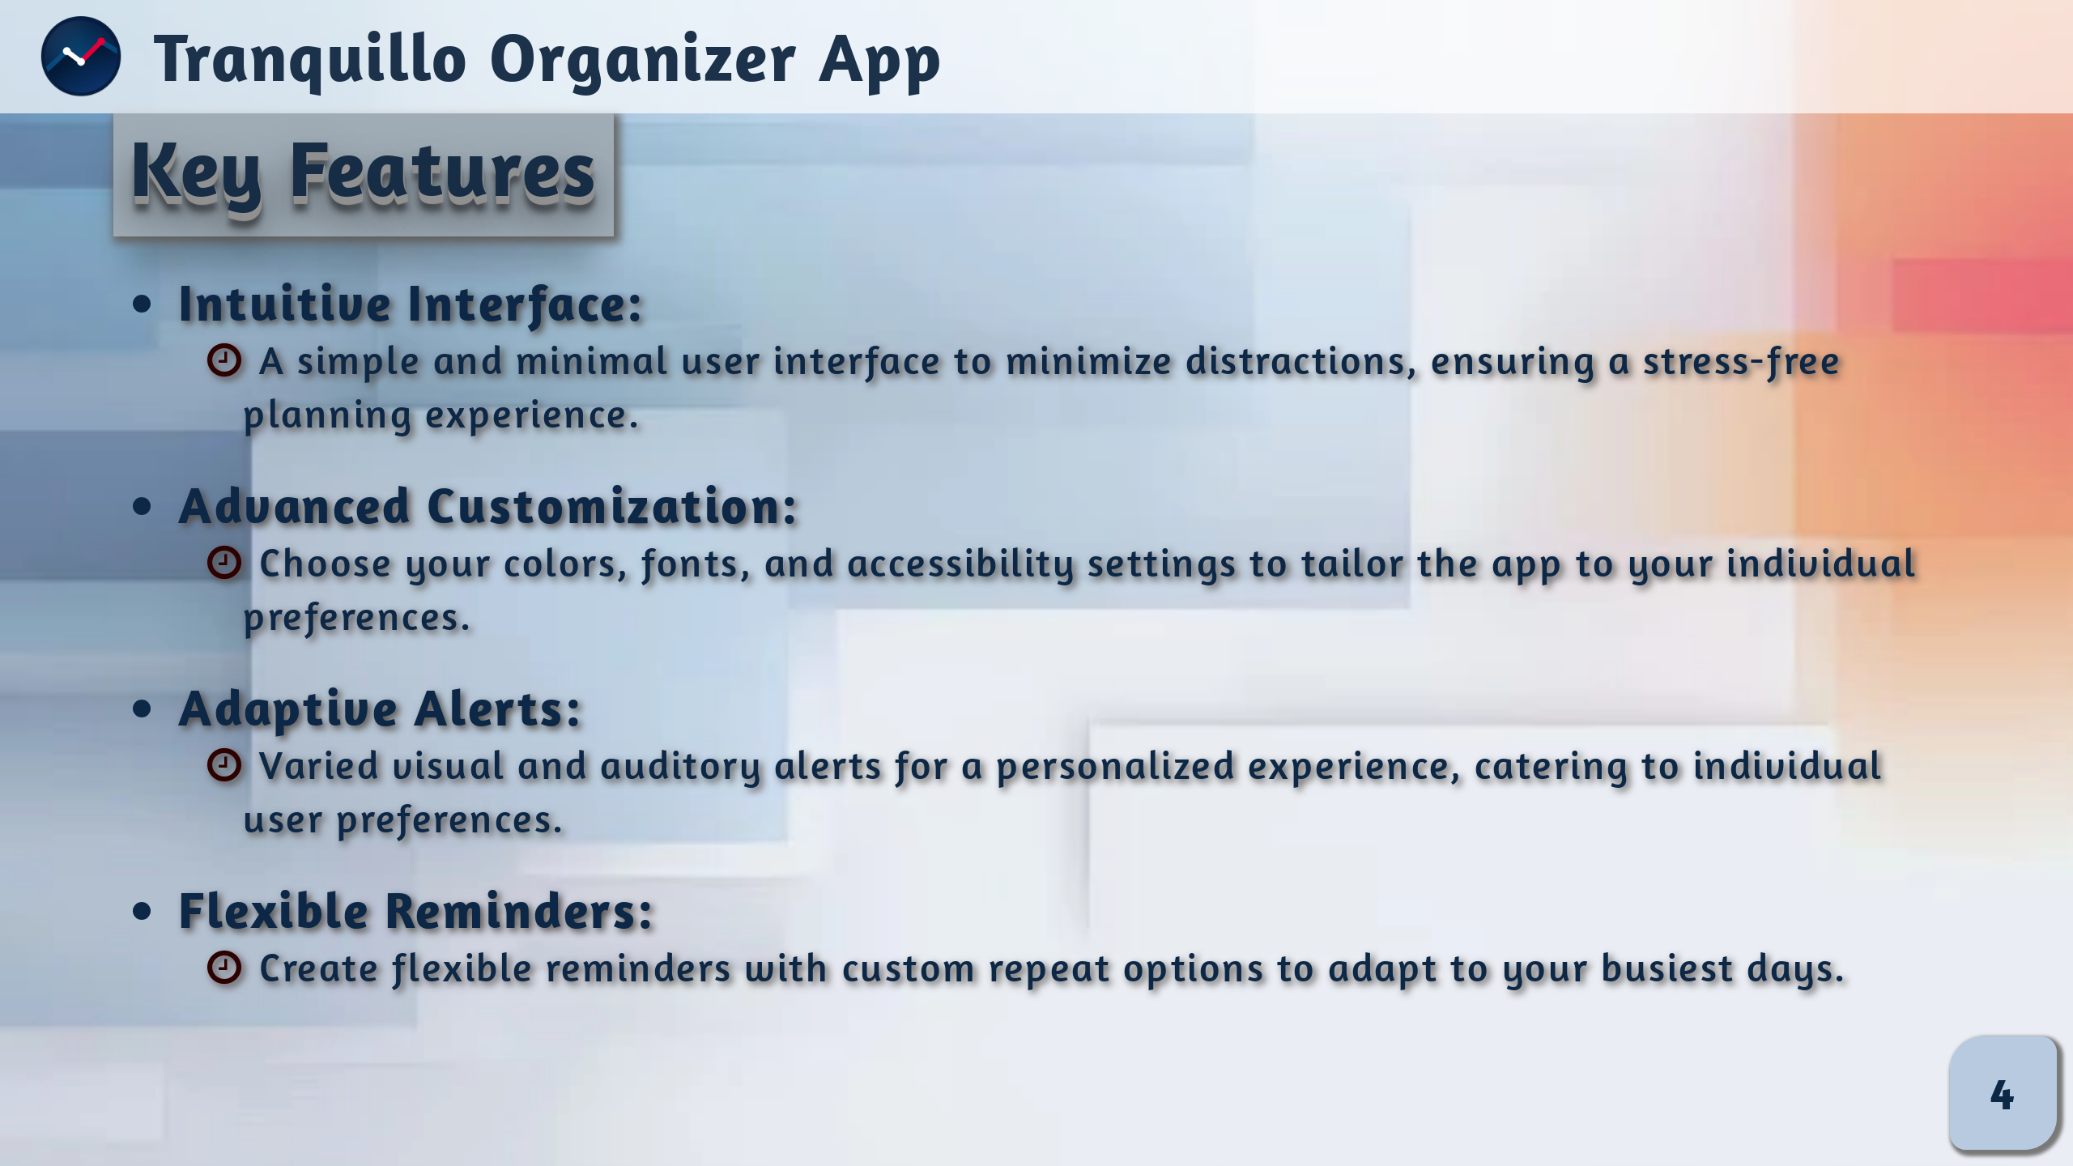
Notes:
# Notes :
The app provides a stress-free planning experience with a user-friendly and minimal interface.
You can customize the app by choosing your own colors, fonts, and accessibility settings.
Visual and auditory alerts adapt to your individual preferences, and reminders are flexible with custom repeat options to fit your busiest days.

Slide 5
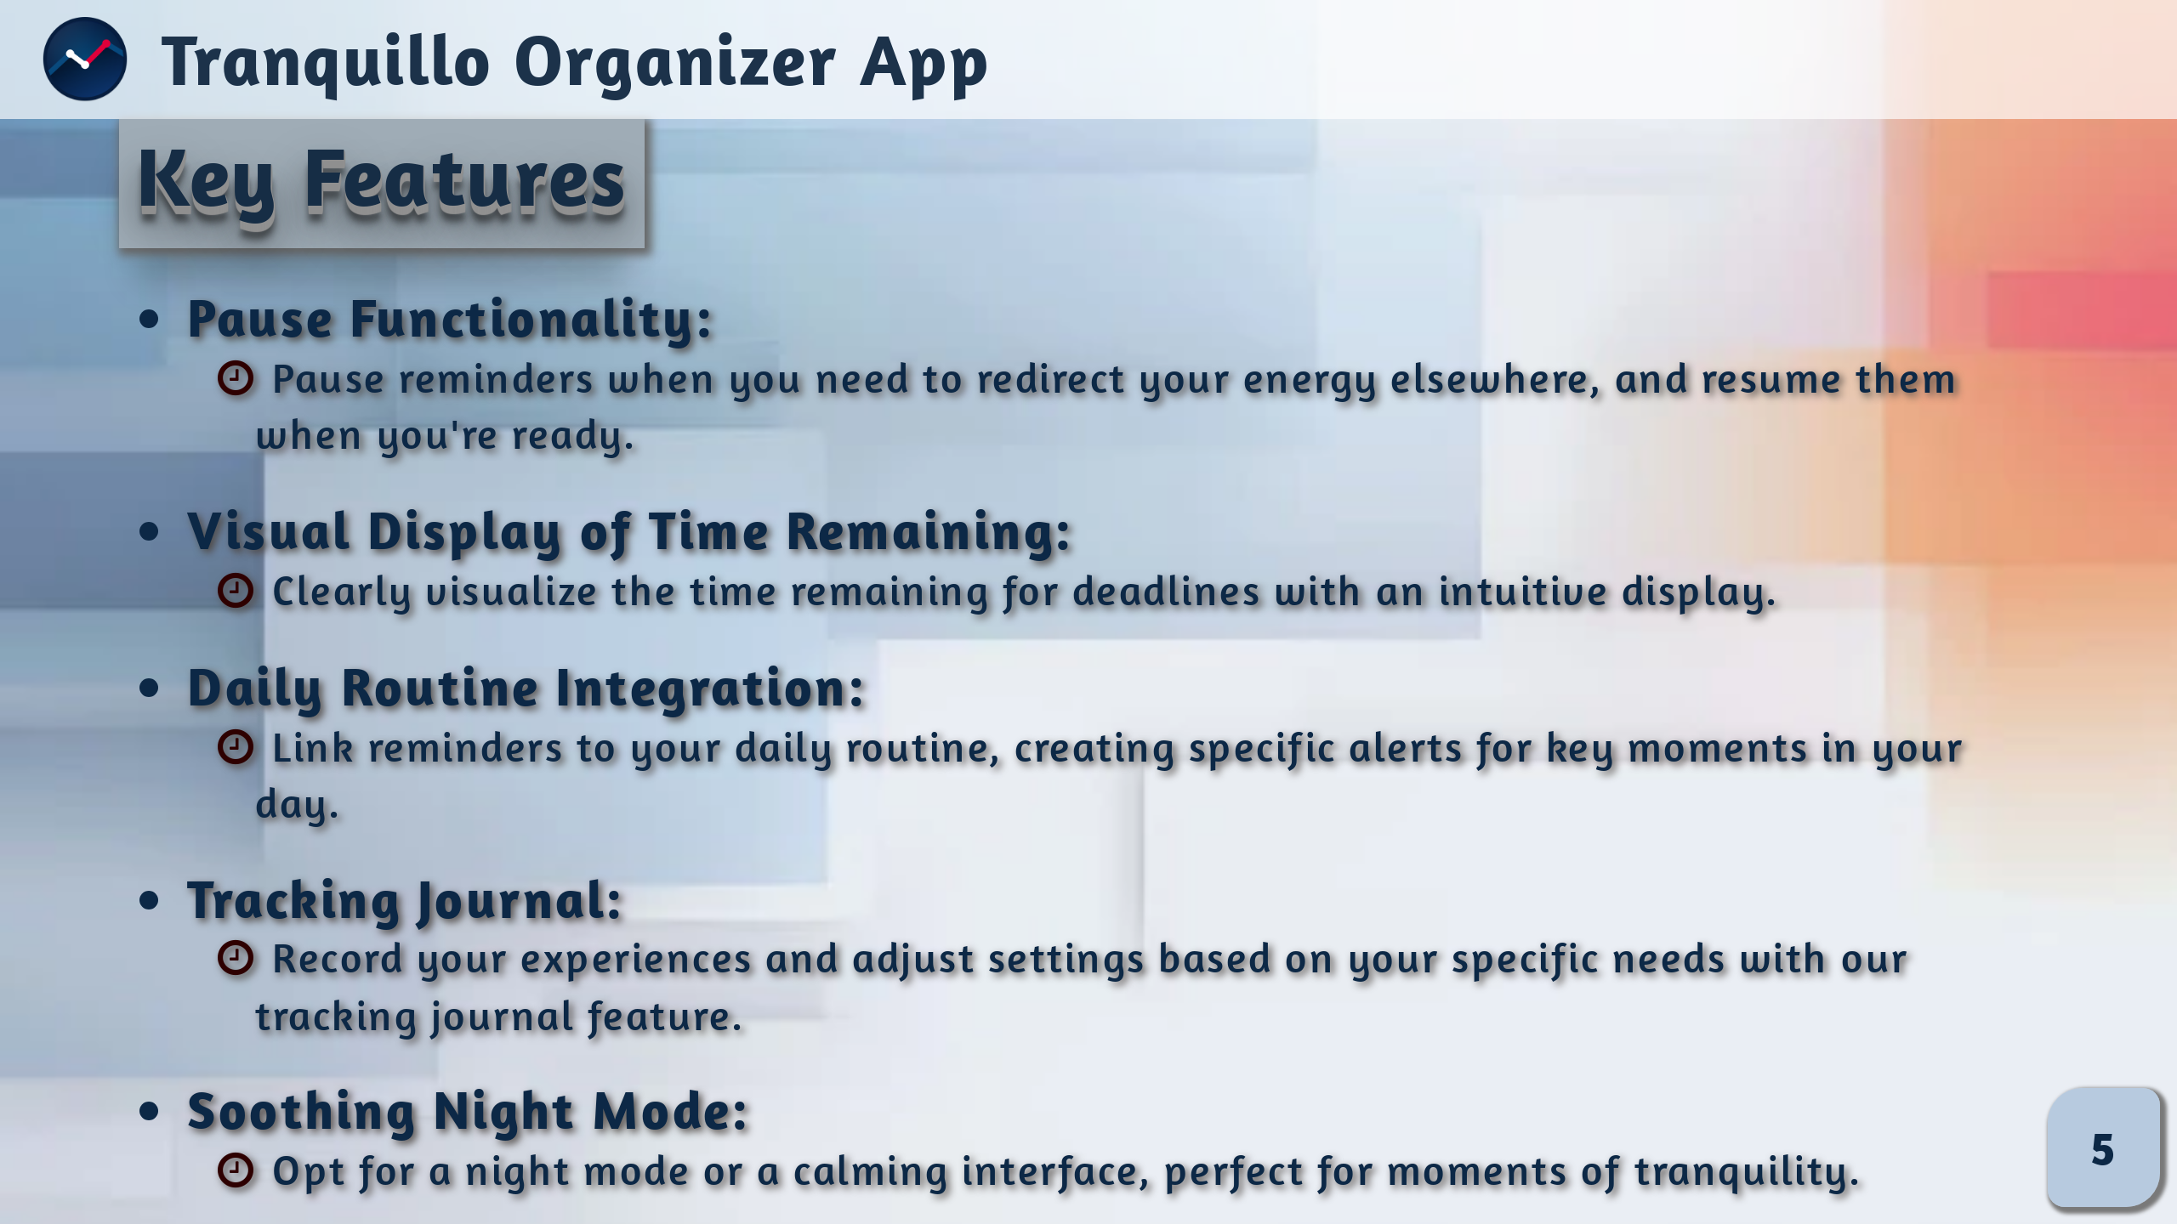
Notes:
# Notes :
The pause function allows you to temporarily halt reminders, offering optimal flexibility.
A visual display of time remaining simplifies deadline management, while integrating reminders into your daily routine creates specific alerts for key moments of the day.
A tracking journal records your experiences, enabling personalized adjustments.
Additionally, you have the option to choose a soothing night mode for moments of calm and relaxation.

Slide 6
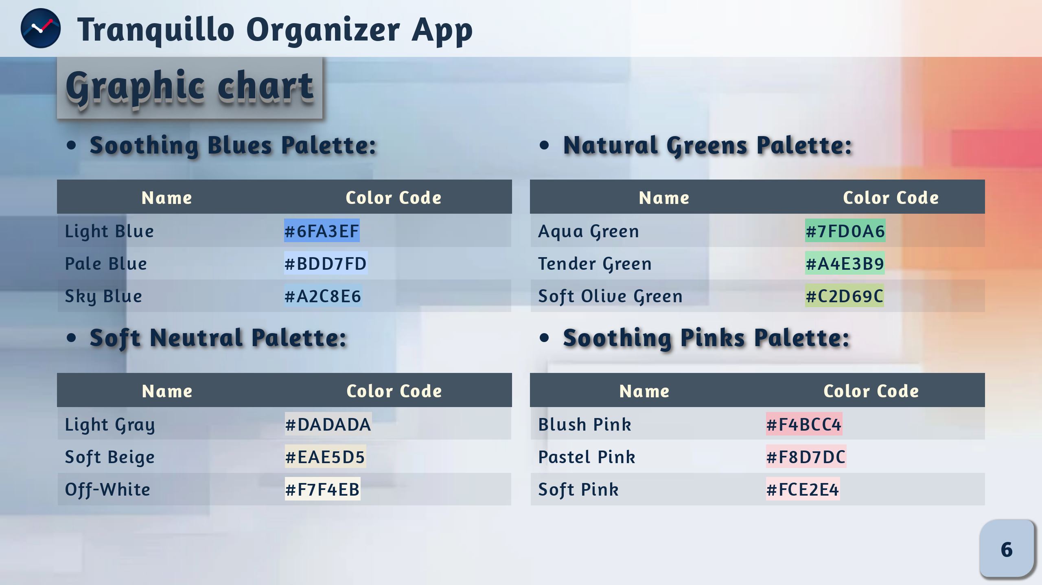

Slide 7
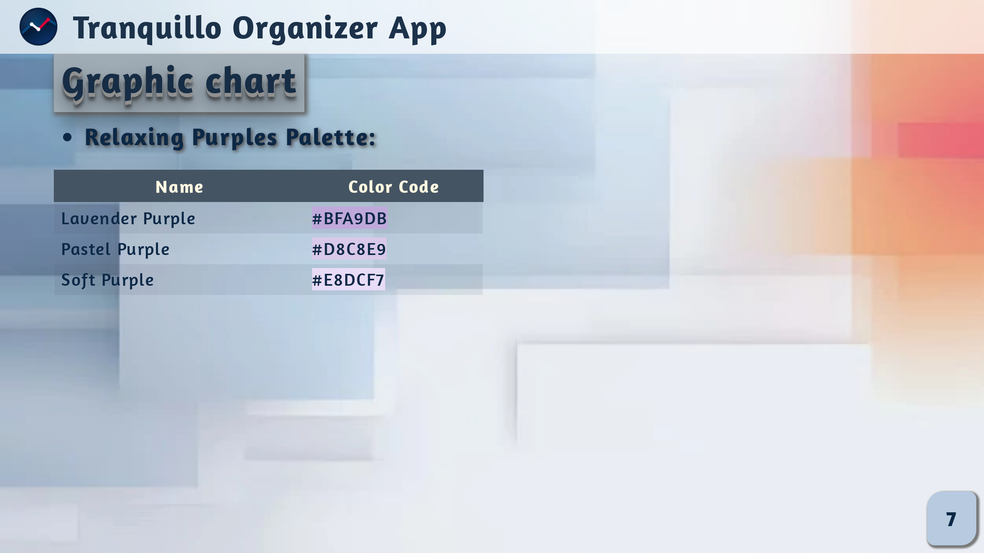

Slide 8
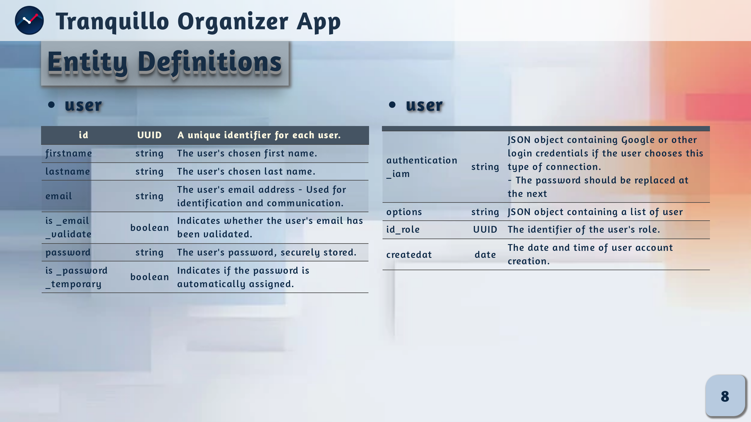
Notes:
# NOTES:
Our User table stores essential information about the user, such as a unique identifier, identity, e-mail address, password and role.
It also tracks e-mail validation status, login preferences.

Slide 9
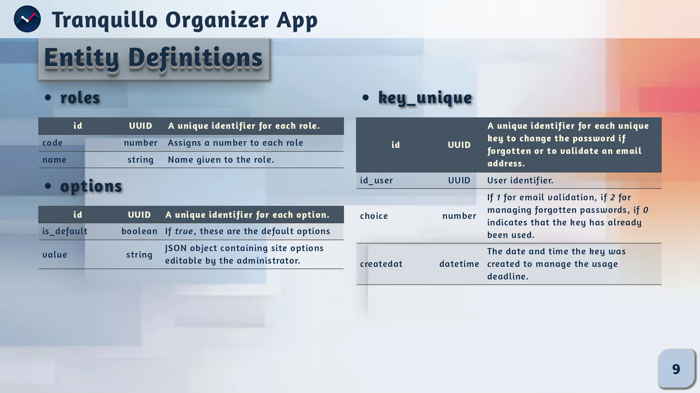
Notes:
# NOTES :
### Roles
The Roles table defines the user's roles as administrator, user or other.
### Options
The Options table stores customizable parameters with values specific to each user.
### key_unique
This table manages unique keys for actions such as password reset or e-mail validation.

Slide 10
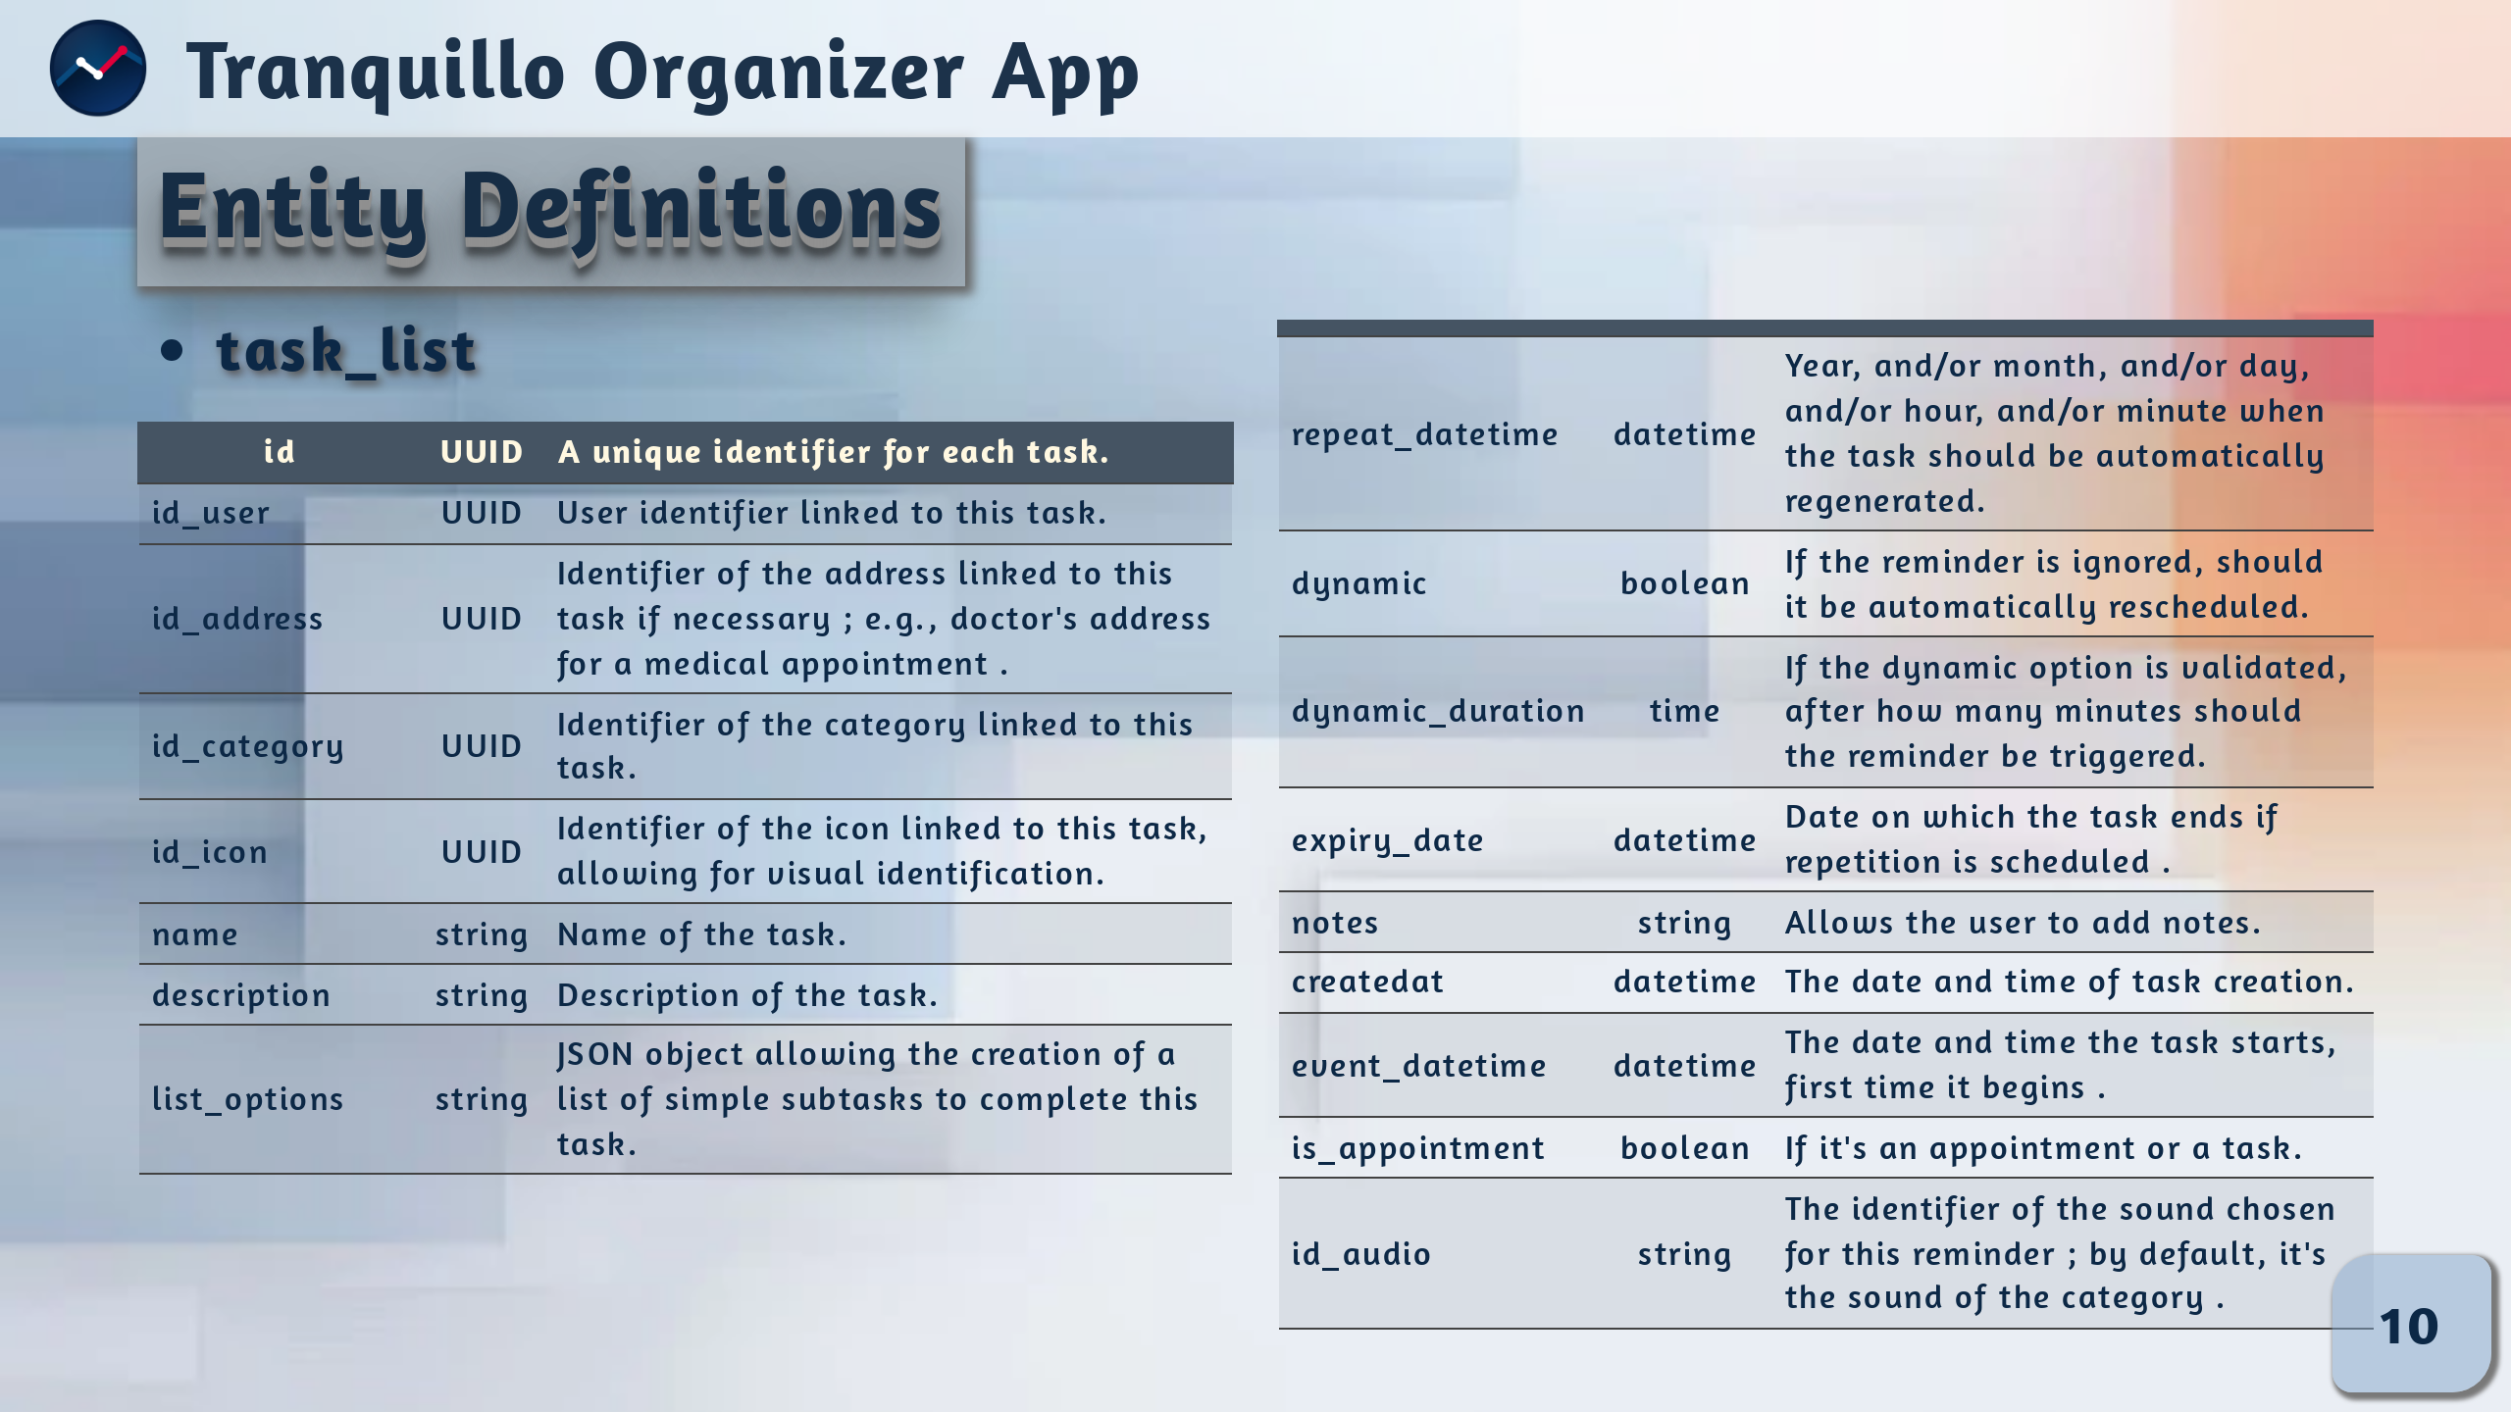
Notes:
# NOTES:
### task_list
Our Task List table manages tasks with details such as name, description and more.
It also manages repeats, dynamic features and notes.
It forms the basis of the application.

Slide 11
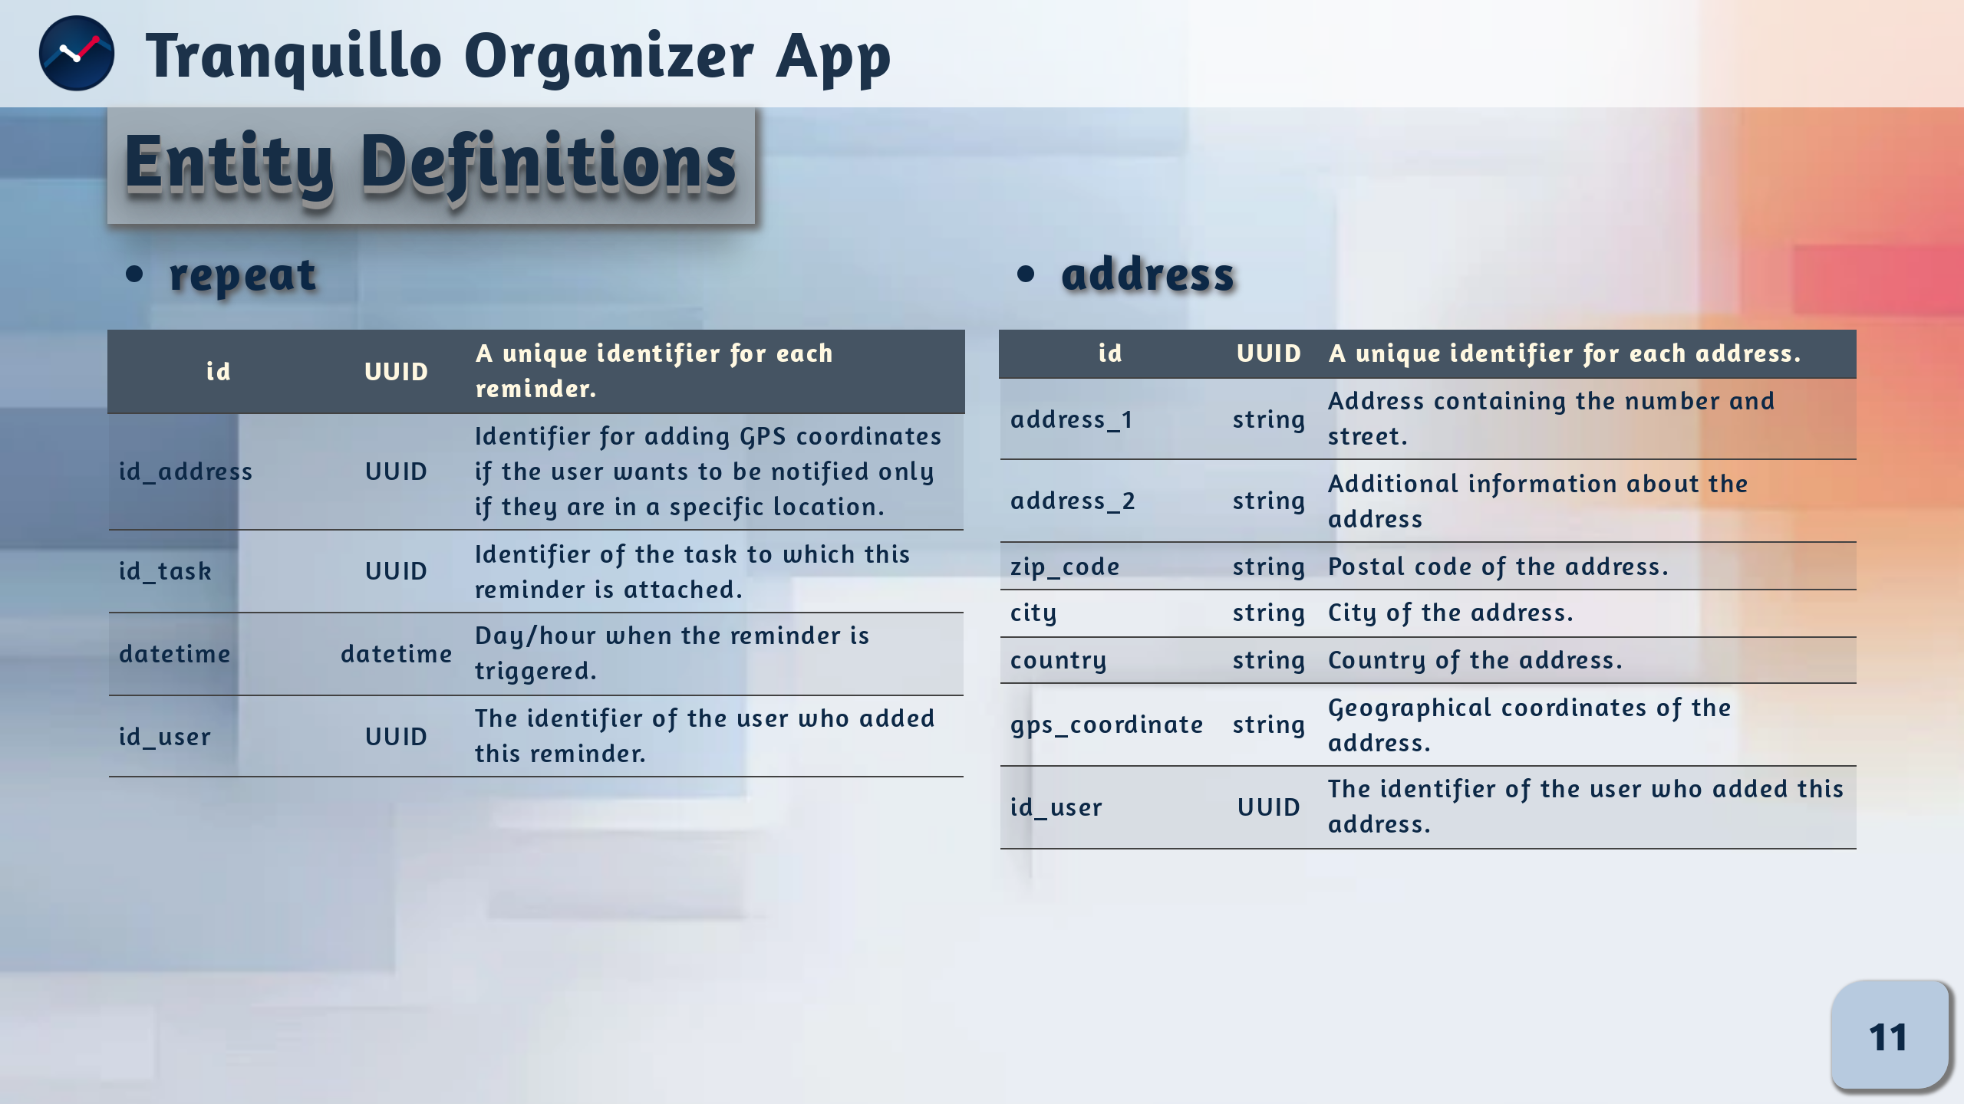
Notes:
# Notes:
### Repeat
The Repeat table handles reminders with various details like.
### Adress
We also find the Adress table stores user-associated addresses, including details and GPS coordinates for options repeat.

Slide 12
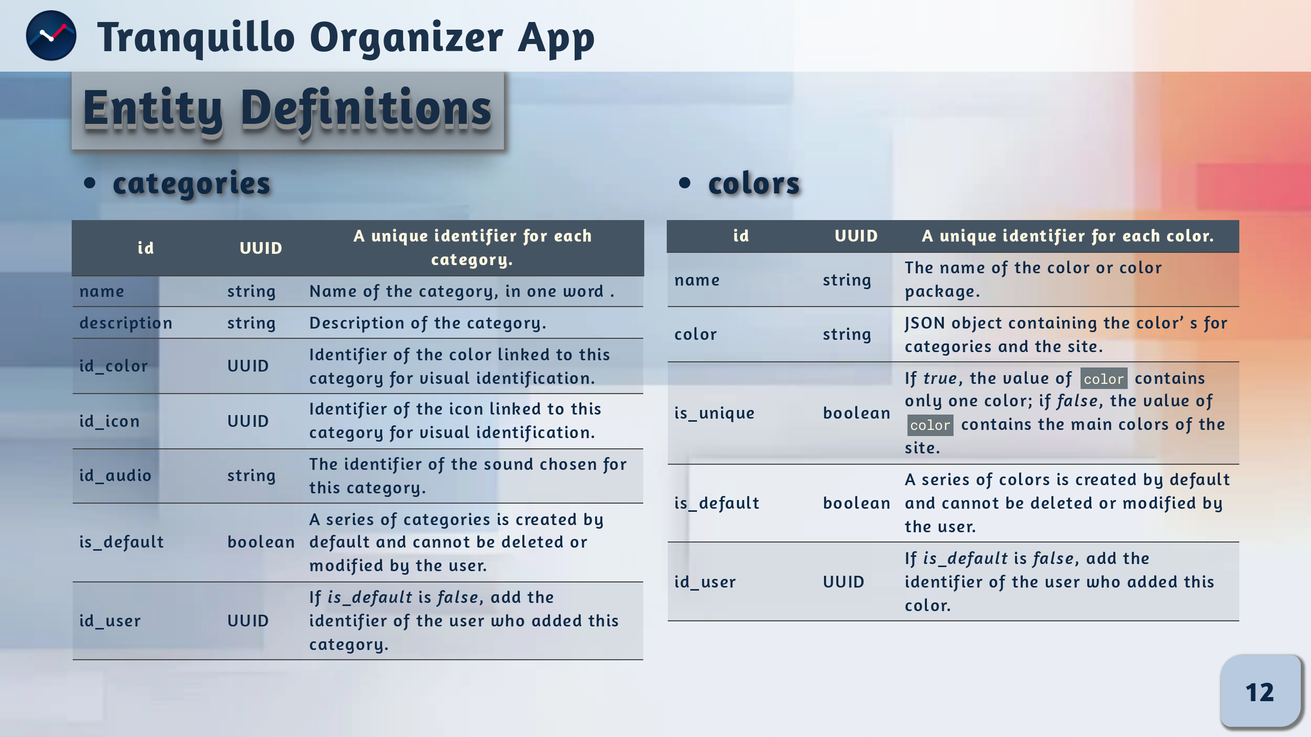
Notes:
# Notes:
Our category table defines task categories with names, descriptions
a name and description, as well as options such as color, icon and audio preference.
The colors, icons and audios tables are optional, making the application more pleasant to use.

Slide 13
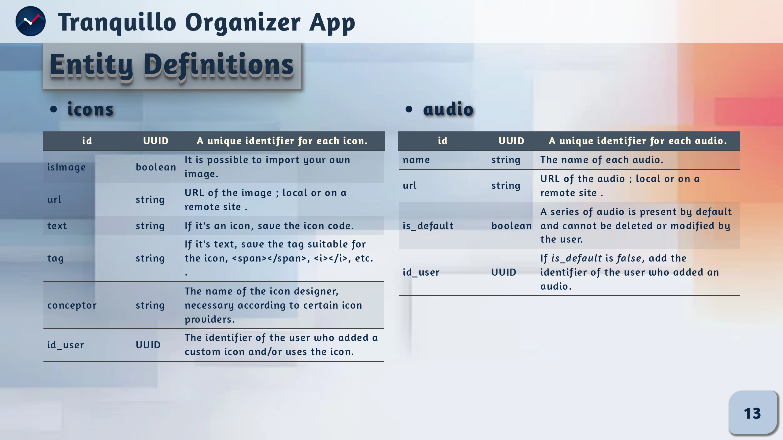

Slide 14
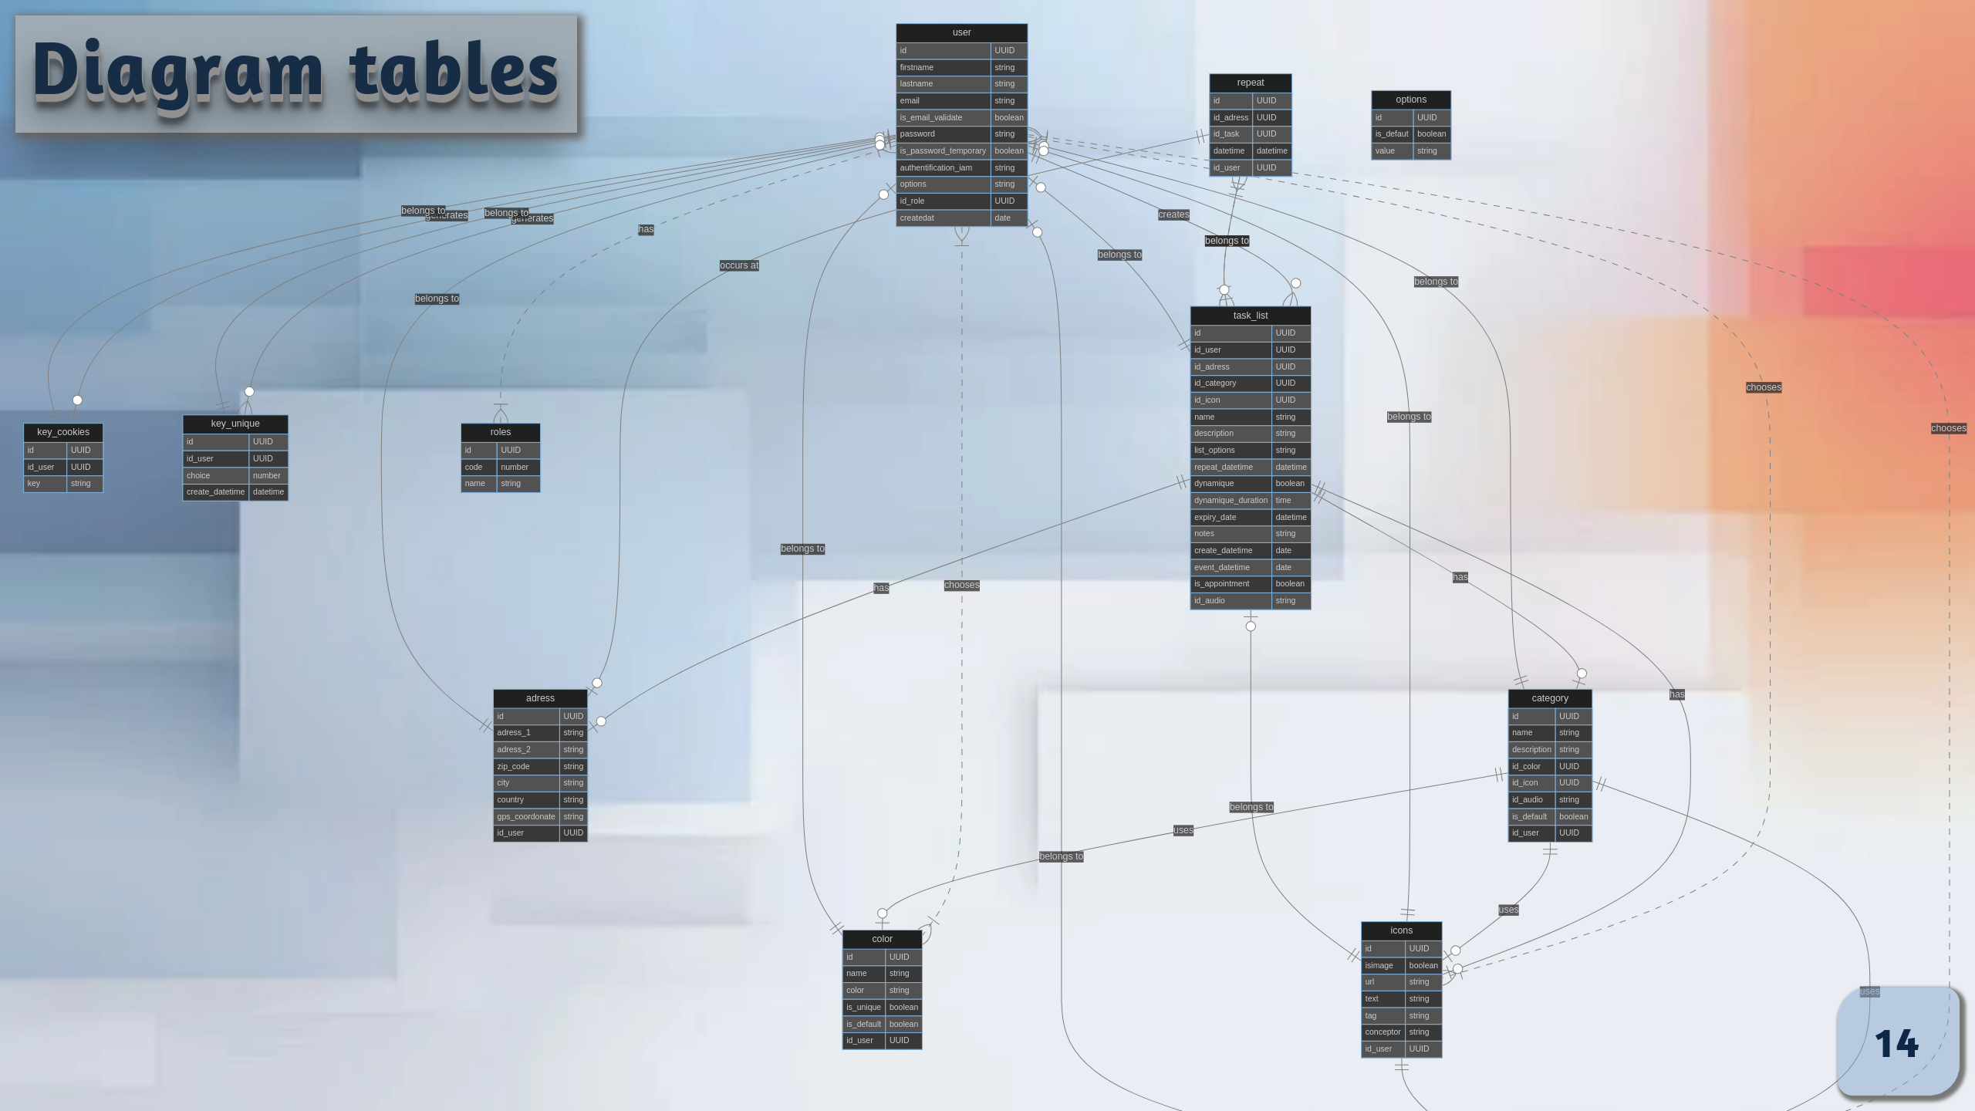

Slide 15
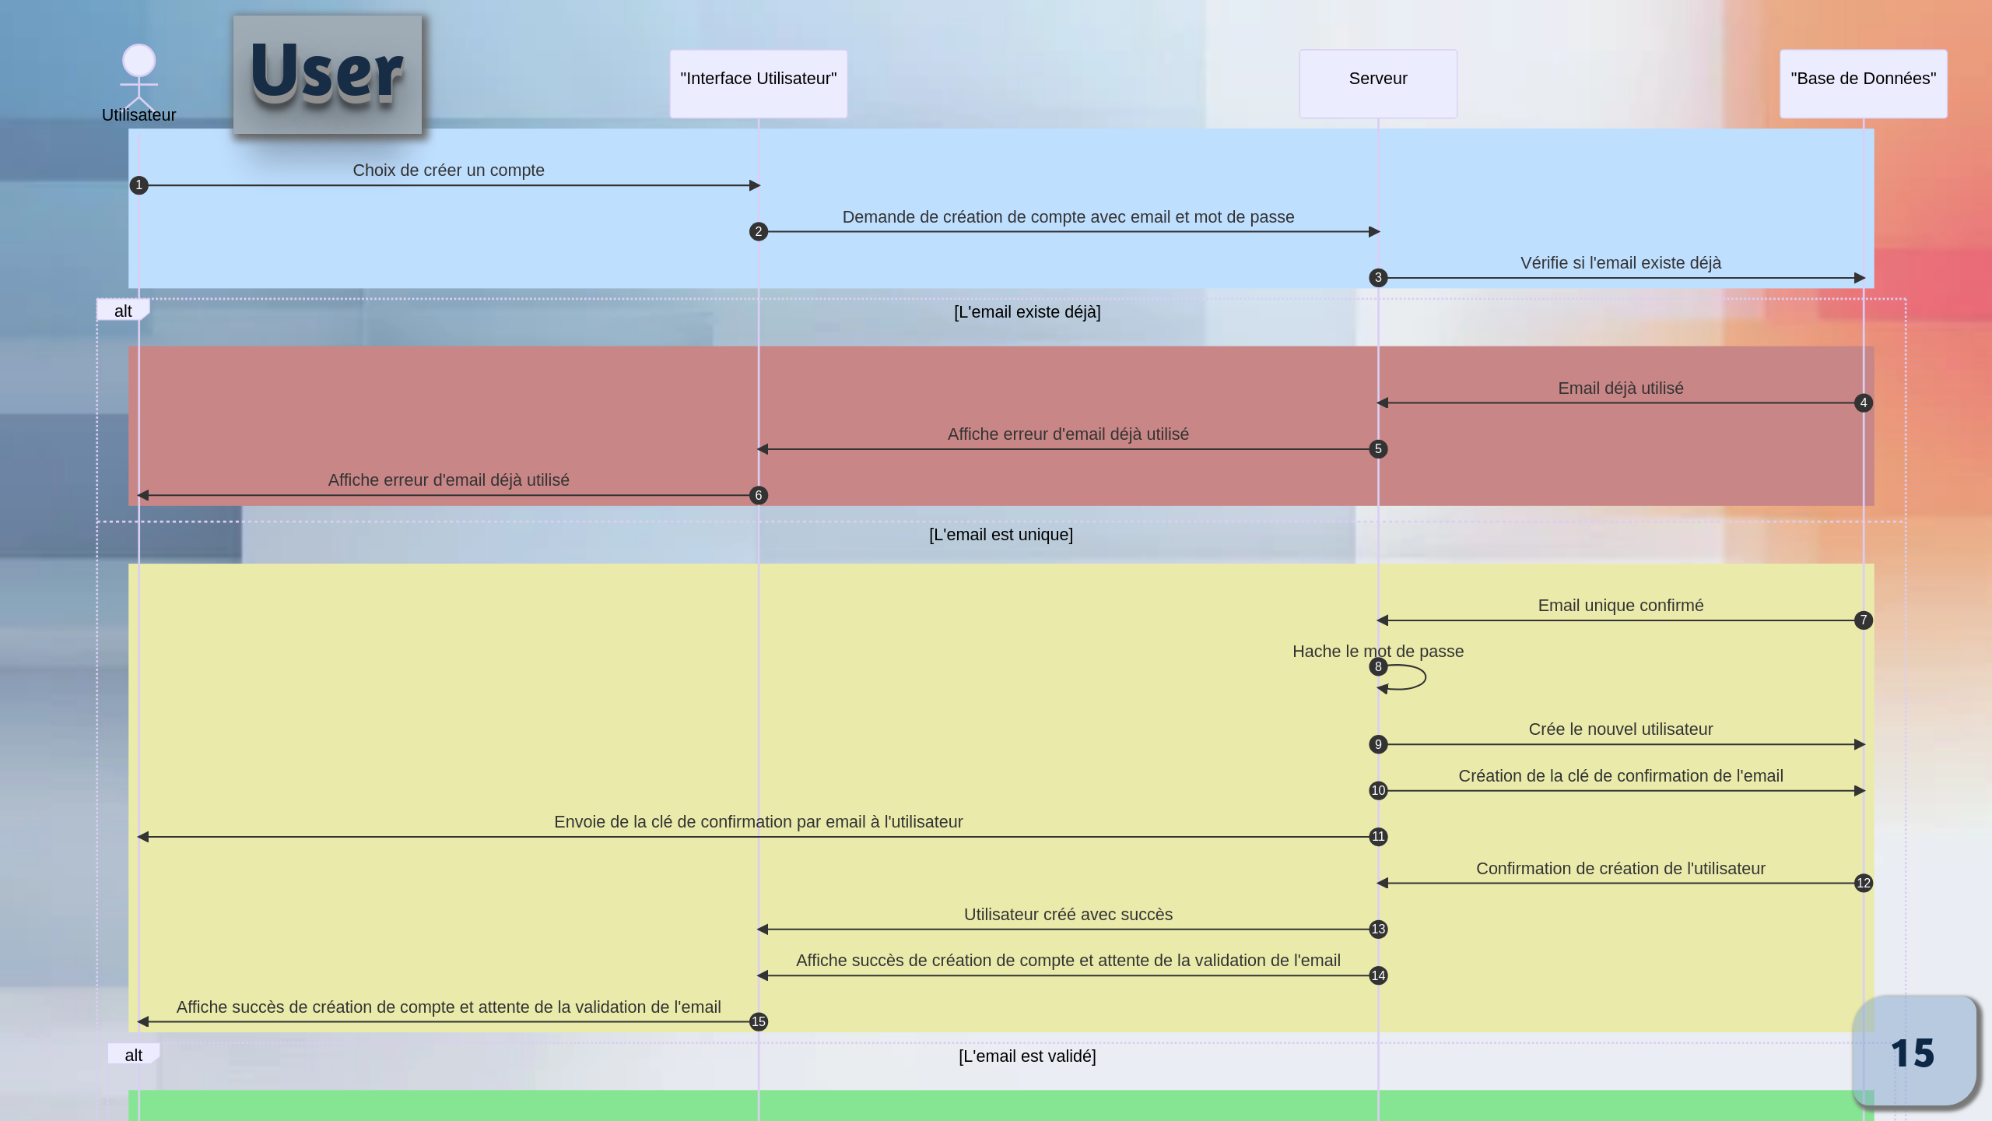
Notes:
# Notes:
1. User Initiates Account Creation
The user decides to create an account, initiating the process through the user interface.
2. Email Existence Check
The server checks if the provided email already exists, preventing duplicate accounts.
3. Unique Email Confirmation
Upon confirming the email is unique, the server securely creates a new account, hashes the password, generates a confirmation key, and notifies the user.

Slide 16
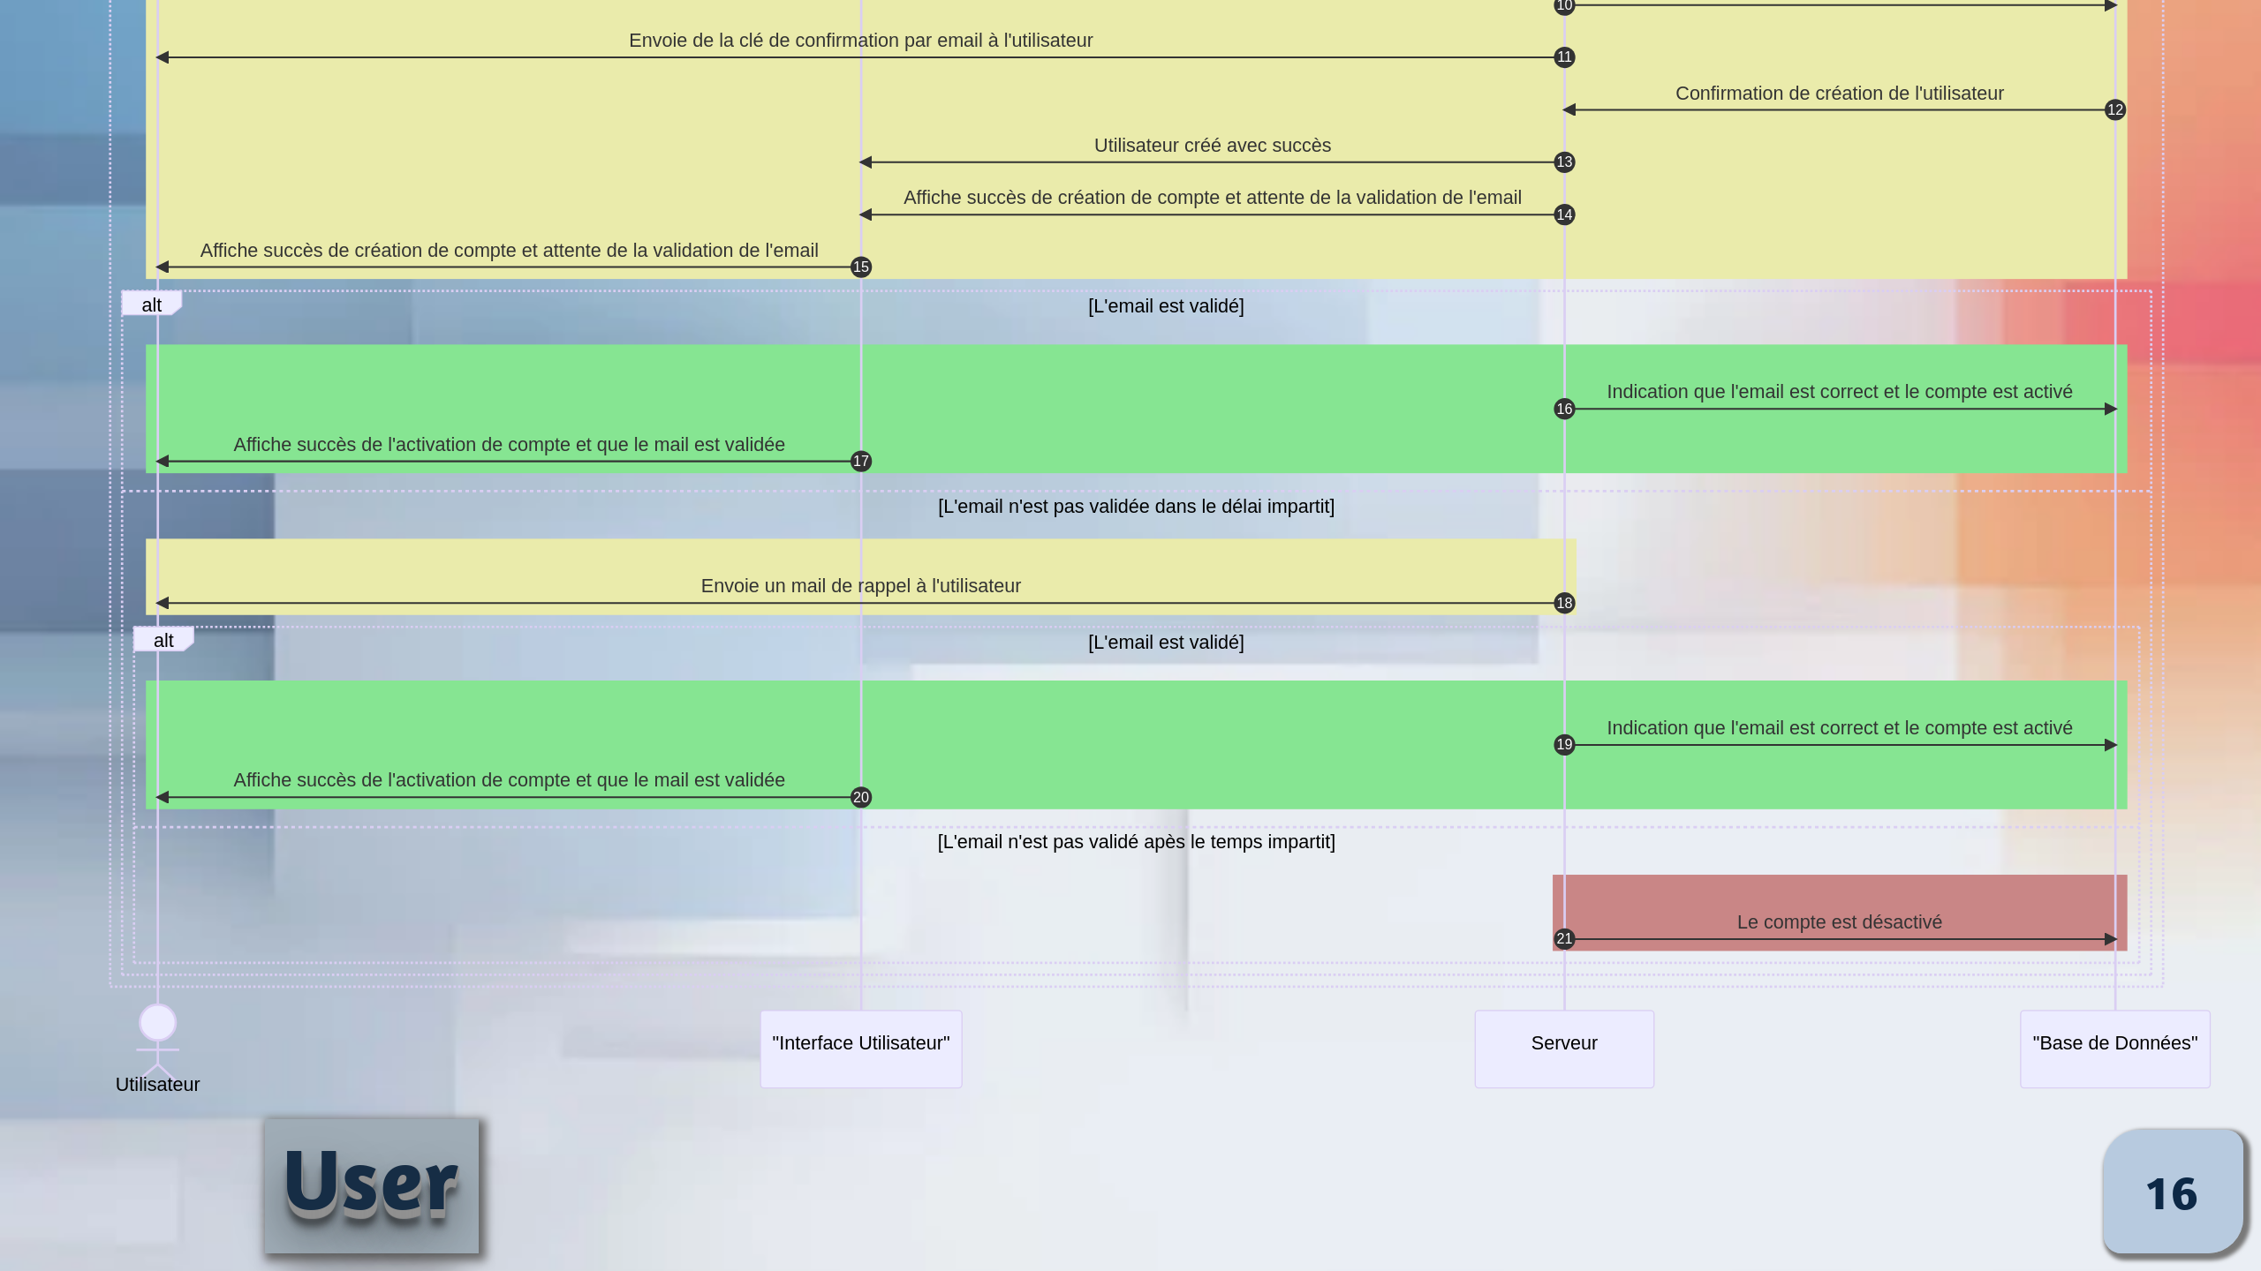
Notes:
# Notes:
4. Email Validation
The system validates the user's email, notifying the user of successful account activation and instructing them to await further instructions.
5. Reminder for Unvalidated Email
If the email remains unvalidated, a reminder email is sent to prompt the user.
6. Email Validation Check after Reminder
The system checks if the user validated their email after the reminder, handling consequences based on the timeframe.
7. Final Consequences
Depending on email validation within the specified timeframe, the account remains active or is marked as inactive if validation doesn't occur.

Slide 17
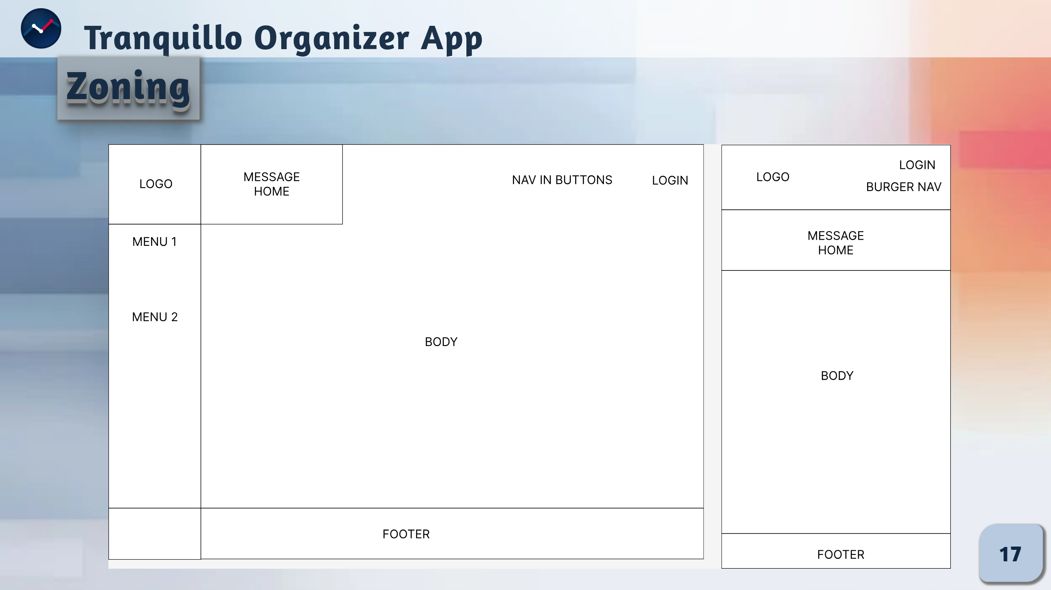
Notes:
# Notes :
On the desktop, the logo is located at the top left, accompanied by a categorized menu just below it.
To the right of the logo, users will find a welcome message, quick navigation buttons and a login option.
The central section is dedicated to viewing tasks, organized by priority, status (in progress, completed, overdue, etc.).
The footer completes the interface in a clear and accessible manner.
On mobile, the user experience is simplified for efficient tactile navigation. The logo remains at the top left, followed by the menu categorized in a burger and quick navigation buttons on the right-hand side.
Below, the welcome message is clearly displayed.
The footer ensures constant accessibility.
This mobile-optimized layout guarantees a fluid, ergonomic user experience.

Slide 18
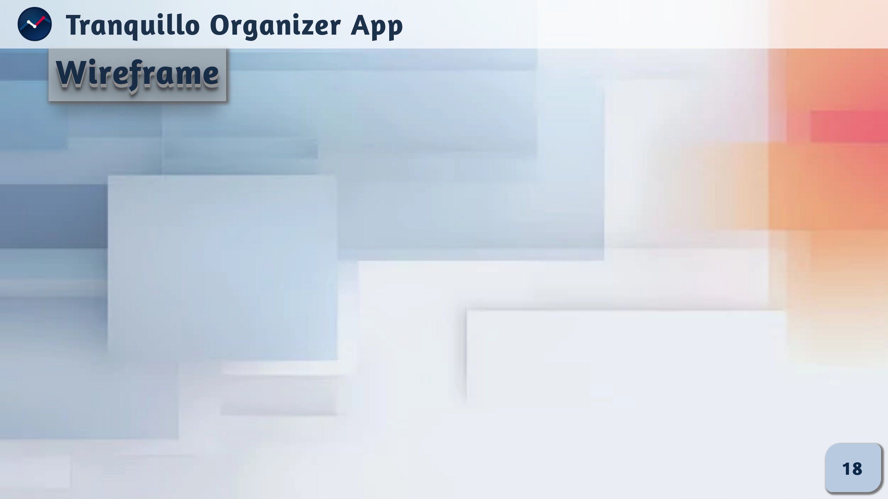

Slide 19
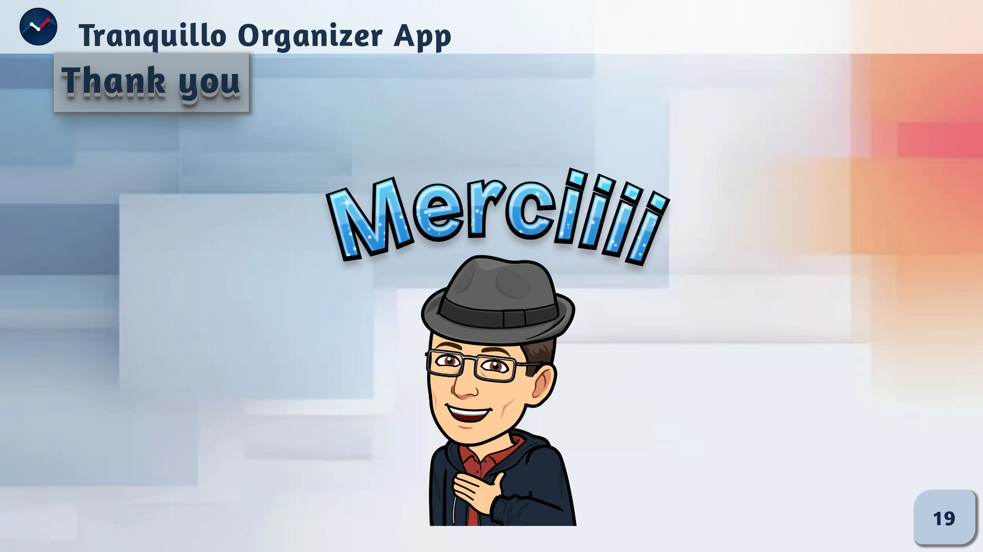
Notes:
# Notes :
Thank you for your time and attention.

